Slide 1
Distributed Computing Introduction
Dr. Barsha Mitra
CSIS Dept, BITS Pilani, Hyderabad Campus
1

Slide 2
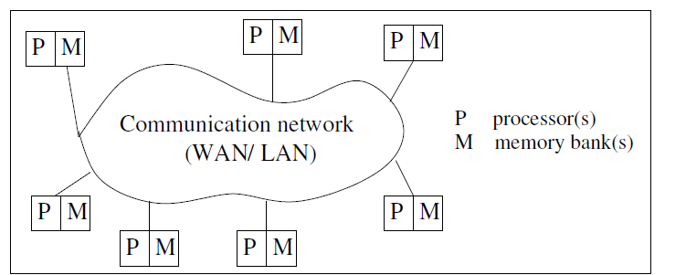
Definition of Distributed Systems
Collection of independent entities cooperating to collectively solve a task
Autonomous processors communicating over a communication network
Course ID: SS ZG526, Title: Distributed Computing
2

Slide 3
Features of Distributed System
No common physical clock
No shared memory - Requires message passing for communication
Geographical seperation
Processors are geographically wide apart
Processors may reside on a WAN or LAN
Autonomy and Heterogeneity
Loosely coupled processors
Different processor speeds and operating systems
Processors are not part of a dedicated system
Cooperate with one another
May offer services or solve a problem jointly
Course ID: SS ZG526, Title: Distributed Computing
3

Slide 4
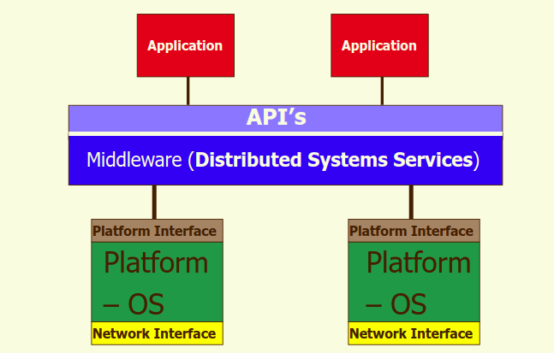
Middleware
Middleware –
distributed software
drives the distributed system
provides transparency of heterogeneity at platform level
Middleware standards:
Common Object Request Broker Architecture (CORBA)
Remote Procedure Call (RPC) mechanism
Distributed Component Object Model (DCOM)
Remote Method Invocation (RMI)
Course ID: SS ZG526, Title: Distributed Computing
4

Slide 5
Motivation for Distributed System
Inherently distributed computation
Resource sharing
Access to remote resources
Increased performance/cost ratio
Reliability
Scalability
Modularity and Incremental Expandability
Course ID: SS ZG526, Title: Distributed Computing
5

Slide 6
Coupling
Interdependency/binding and/or homogeneity among modules, whether hardware or software (e.g., OS, middleware)
High coupling → tightly coupled modules
Low coupling → loosely coupled modules
Course ID: SS ZG526, Title: Distributed Computing

Slide 7
Parallel Systems
Multiprocessor systems
E.g., Omega, Butterfly Networks
Multicomputer parallel systems
E.g., NYU Ultracomputer, CM* Connection Machine, IBM Blue gene
Array processors (collocated, tightly coupled, common system clock, may not have shared memory)
E.g., DSP applications, image processing
Course ID: SS ZG526, Title: Distributed Computing
7

Slide 8
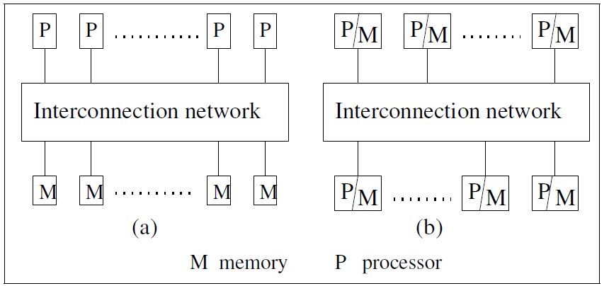
UMA Model
Direct access to shared memory
Access latency - waiting time to complete an access to any memory location from any processor
Access latency is same for all processors
Processors
Remain in close proximity
Connected by an interconnection network
Course ID: SS ZG526, Title: Distributed Computing
8

Slide 9
UMA Model
Interprocess communication occurs through read and write operations on shared memory
Processors are of same type
Remain within same physical box/container
Processors run the same operating system
Hardware & software are very tightly coupled
Interconnection network to access memory may be
Bus
Multistage switch
Course ID: SS ZG526, Title: Distributed Computing
9

Slide 10
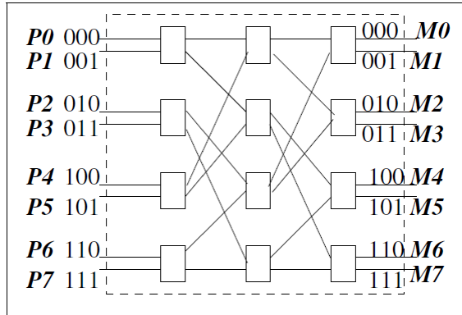
Omega Network
Multi-stage networks formed by 2 x 2 switching elements
Data can be sent on any one of the input wires
n-input and n-output network uses:
log₂(n) stages
log₂(n) bits for addressing
n processors, n memory banks
Course ID: SS ZG526, Title: Distributed Computing
10

Slide 11
Omega Network
(n/2)log₂(n) switching elements of size 2x2
Interconnection function: Output i of a stage is connected to input j of next stage:
j = 2i, for 0 ≤ i ≤ n/2 – 1
= 2i + 1 – n, for n/2 ≤ i ≤ n – 1
left-rotation operation on the binary representation of i to get j
Course ID: SS ZG526, Title: Distributed Computing
11

Slide 12
Omega Network
Routing function: from input line i to output line j
considers j and stage number s, s ϵ [0, log₂(n) – 1]
in a stage s switch
if (s + 1)^{th} MSB of j is 0, then route on upper wire
else [i.e., (s + 1)^{th} MSB of j is 1], route on lower wire
Course ID: SS ZG526, Title: Distributed Computing
12

Slide 13
Multicomputer Parallel Systems
multiple processors do not have direct access to shared memory
usually do not have a common clock
processors are in close physical proximity
very tightly coupled (homogenous hardware and software)
connected by an interconnection network
communicate either via a common address space or via message-passing
Course ID: SS ZG526, Title: Distributed Computing
13

Slide 14
NUMA Model
non-uniform memory access architecture
multicomputer system having a common address space
latency to access various shared memory locations from the different processors varies
Course ID: SS ZG526, Title: Distributed Computing
14

Slide 15
Multicomputer Parallel Systems
2-D wraparound mesh
k x k mesh contains k² processors
processor + memory
Course ID: SS ZG526, Title: Distributed Computing

Slide 16
Multicomputer Parallel Systems
processor + memory
k-dimensional hypercube has 2^{k} processor-and-memory units (nodes)
each dimension is associated with a bit position in the label
labels of two adjacent nodes differ in the k^{th} bit position for dimension k
shortest path between any two processors → Hamming distance
Hamming distance <= k
Course ID: SS ZG526, Title: Distributed Computing

Slide 17
Multicomputer Parallel Systems
routing in the hypercube is done hop-by-hop
multiple routes exist between any pair of nodes → provides fault tolerance and congestion control mechanism
Course ID: SS ZG526, Title: Distributed Computing

Slide 18
Parallelism/Speedup
measure of the relative speedup of a specific program on a given machine
depends on
number of processors
mapping of the code to the processors
speedup = T(1)/T(n)
T(1) = time with a single processor
T(n) = time with n processors
Course ID: SS ZG526, Title: Distributed Computing

Slide 19
Parallel/Distributed Program Concurrency
non-communication and non-shared memory access
includes the communication or shared memory access operations
Course ID: SS ZG526, Title: Distributed Computing

Slide 20
Distributed Communication Models
Remote Procedure Call (RPC)
Publish/Subscribe Model
Course ID: SS ZG526, Title: Distributed Computing

Slide 21
RPC
Called procedure code may reside on a remote machine
make remote procedure call appear like local procedure call
goal is to hide the details of the network communication (namely, the sending and receiving of messages)
calling procedure should not be aware that the called procedure is executing on a different machine
Source: http://web.cs.wpi.edu/~rek/DCS/D04/Communication.pdf
Course ID: SS ZG526, Title: Distributed Computing
21

Slide 22
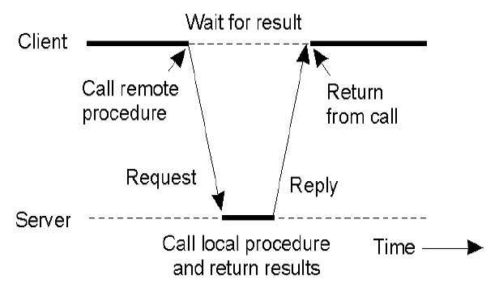
RPC between Client & Server
The client procedure calls a client stub for passing parameters
The client stub marshals the parameters, builds the message, and calls the local OS
The client's OS sends the message to the remote OS
The server’s remote OS gives message to a server stub
The server stub demarshals the parameters and calls the desired server routine
Source: http://web.cs.wpi.edu/~rek/DCS/D04/Communication.pdf
Course ID: SS ZG526, Title: Distributed Computing

Slide 23
RPC between Client & Server
The server routine does work and returns result to the server stub
The server stub marshals the return values into the message and calls local OS
The server OS sends the message to the client's OS
The client's OS gives the message to the client stub
The client stub demarshals the result, and execution returns to the client
Source: http://web.cs.wpi.edu/~rek/DCS/D04/Communication.pdf
Course ID: SS ZG526, Title: Distributed Computing

Slide 24
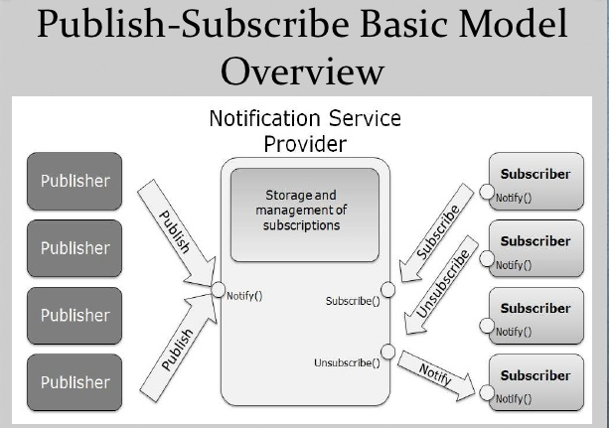
Publish/ Subscribe Model
allows any number of publishers to communicate with any number of subscribers asynchronously
form of multicasting
events are produced by publishers
interested subscribers are notified when the events are available
information is provided as notifications
subscribers continue their tasks until they receive notifications
Course ID: SS ZG526, Title: Distributed Computing

Slide 25
References
Ajay D. Kshemkalyani, and Mukesh Singhal, Chapter 1, “Distributed Computing: Principles, Algorithms, and Systems”, Cambridge University Press, 2008.
https://medium.com/@rashmishehana_48965/middleware-technologies-e5def95da4e
http://wiki.c2.com/?PublishSubscribeModel
https://www.slideshare.net/ishraqabd/publish-subscribe-model-overview-13368808/5
Course ID: SS ZG526, Title: Distributed Computing
25

Slide 26
Thank You
Course ID: SS ZG526, Title: Distributed Computing
26

